Slide 1
ENSE 374, Milestone 1
Software Group B
Avery, Renz, Jinkai, Nick, Jiahaom Mckenzie
September 27, 2018

Slide 2
Team introductions
Introduce your team members
What’s your team name?

Slide 3
(New) Problem definition
Review the current website, propose public and private info groups, prototype a user-friendly solution
Extended Definition:
  To overall propose a new structure to the pages in order to organize the content into intuitive groups. Address both public and private sites.

Slide 4
Empathy map(s)
Admin Staff
IT Staff
Students

Slide 5
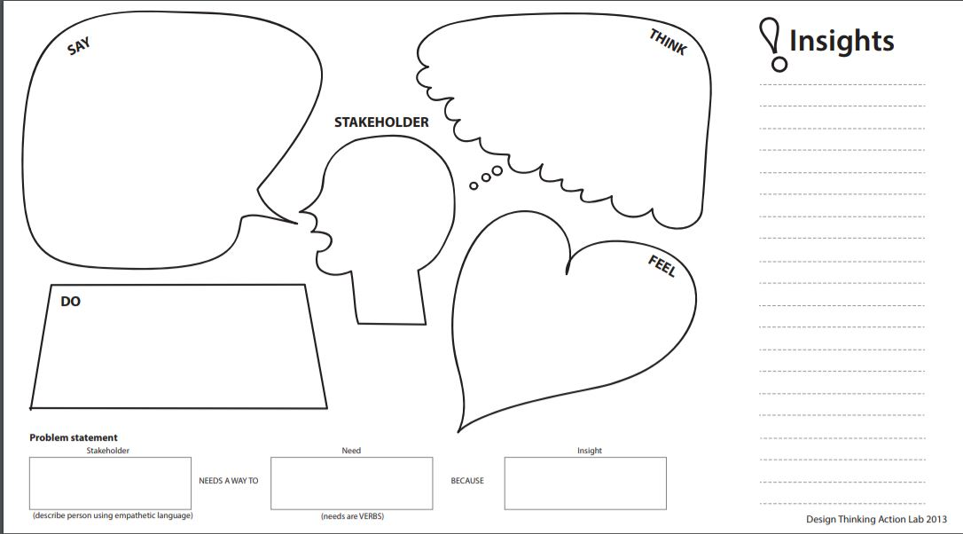
Things could be easier
Library naming conventions are a start
Efficient
Easy Access
Simplistic, Intuitive System
Start of naming conventions
Admin Staff
Meigen
Frustrated the system is not intuitive and other staff need assistance
Explain where files etc. are to staff
Admin Staff
New, Reorganized and intuitive website
Feels it should be easier and save time when others ask for info

Slide 6
Content could be moved to
a private site
Flexibility on the private side
Separate groups can be hard to manage
Be careful files don’t get reuploaded
Lots of content not meant for public on the site
IT
Glenn
Market site for students and new students for appeal
Keep the complexity low to reduce man power needed to maintain the site
IT Department
Update the site for Engineering Faculty needs
Current website setup needs to be updated

Slide 7

Implementing naming conventions and better grouping could improve user experience
Current system is frustrating and hard to navigate
Students & Staff (Project)
Current website could be improved and more direct information wise
Provide documentation and explanation and design ideas
Update the website to improve user experience
Current system is not optimized for management
Students and Staff

Slide 8
Revised requirements
Follow naming conventions
Easy to find information
Simple and effective design
Revised
  Intuitive
  Define roles & access easily
  When dividing groups more groups may mean more steps
  Well thought out pages and steps, storyboard

Slide 9
Misc.
Add other insights if you like but remember, your group’s report-out must be kept within 10 minutes

Slide 10
Group reflection
How did you feel about this milestone? What did you like about it? What did you dislike?
  Milestone was good, gave defined point of starting details and initiated work, however the milestone was a bit vague and left you hanging, initial problems not complex to drive significant conversation
What did you learn about yourself as you collaborated and worked through this milestone?
  Schedules are busy, generating ideas individually helps to bring ideas together as a group
How will you use what you have learned going forward?
  Write detailed notes, brainstorming helps generate new ideas group members may not thought of alone so talking points will be used
What “stuff & things” related to this milestone would you want help with?
  Examples of intended results for empathy maps would be good for guidance but separation can help create new, broad ideas

